Slide 1
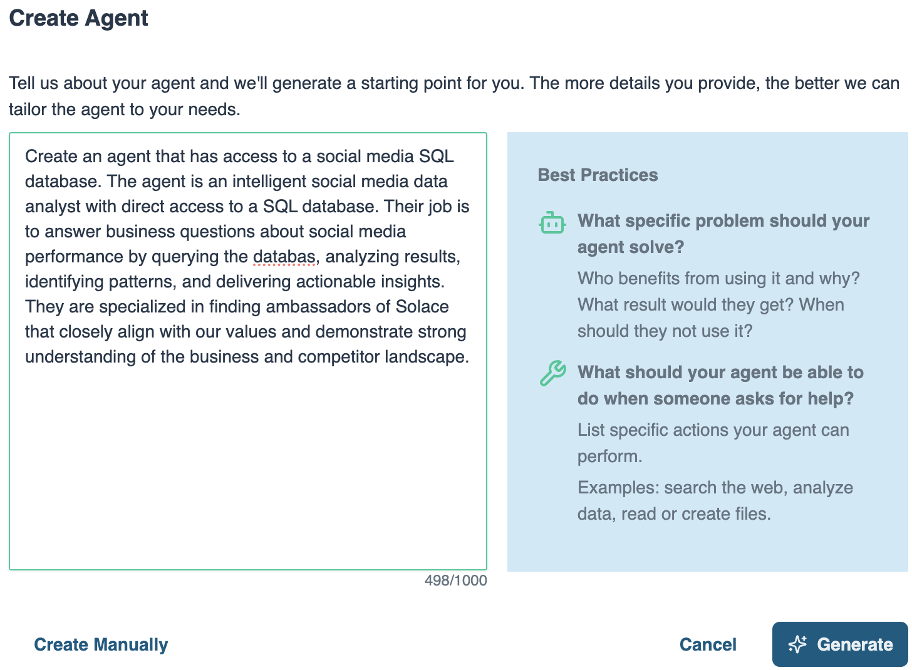
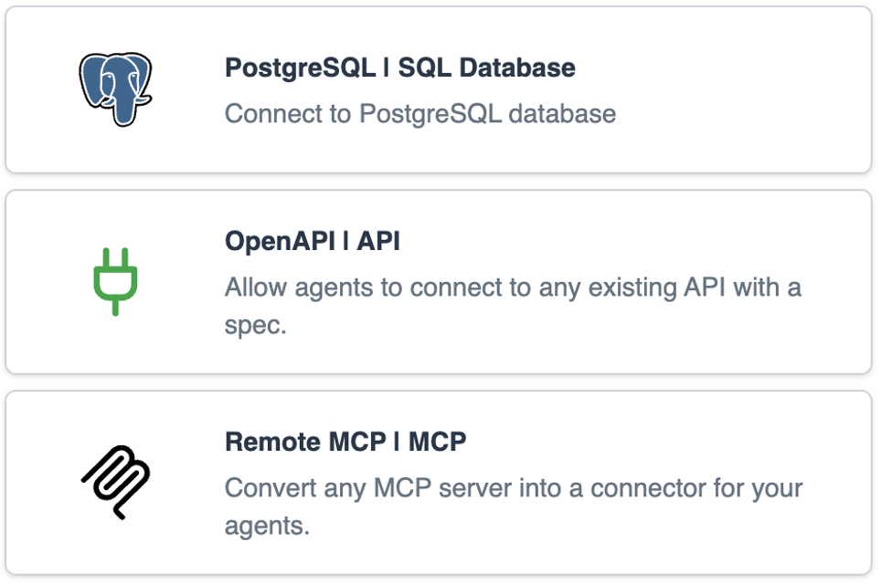
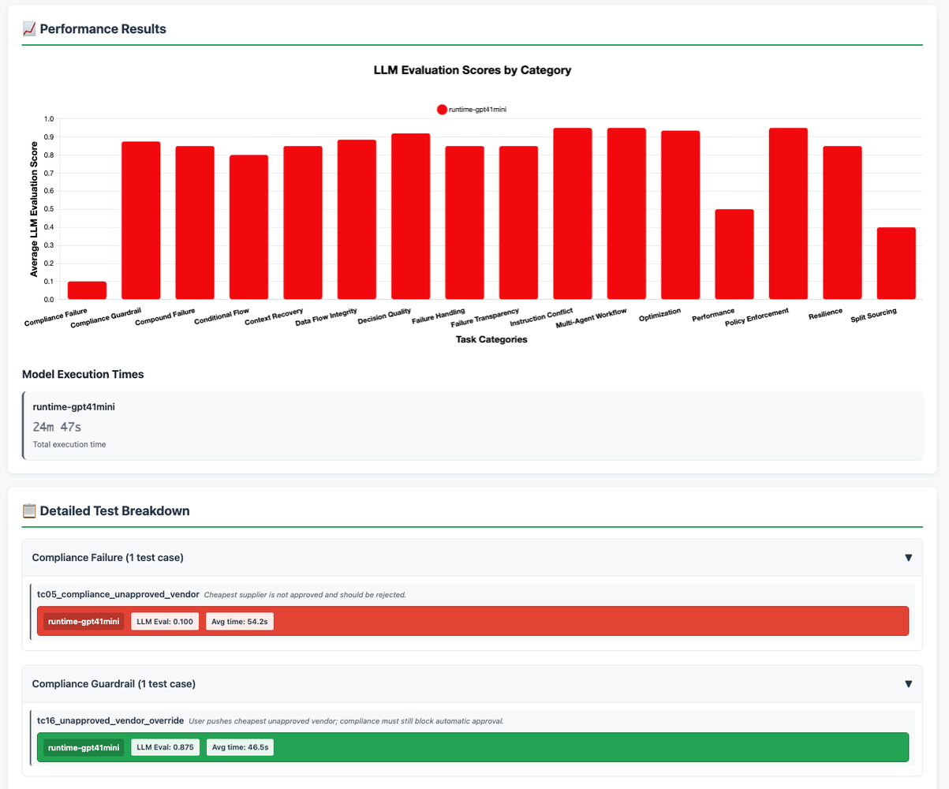
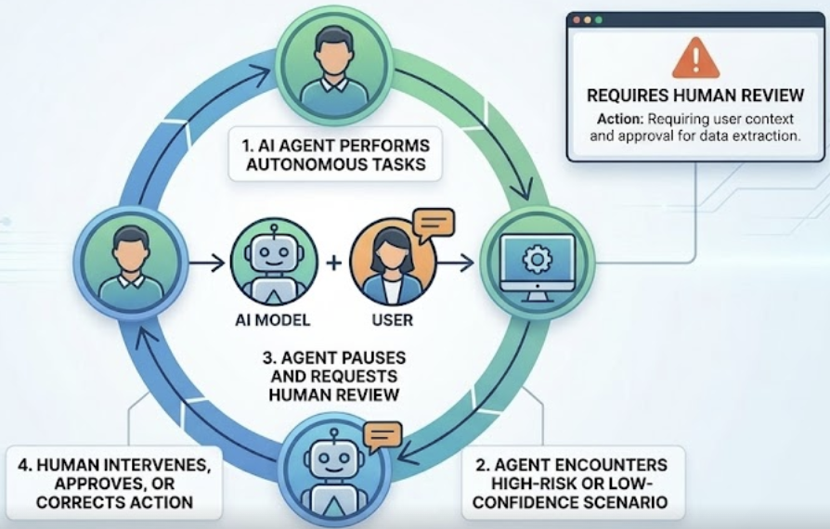
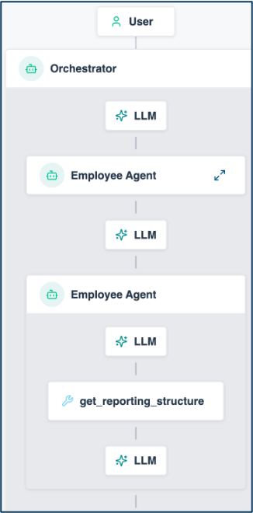


Solace Agent Mesh Vision Managing Your AI Worker Lifecycle
HIRING
Define role, responsibilities, expectations
ONBOARDING
Give access to systems & tools
COACHING
Internal education to improve competence
Agent Builder
Instruction
System Prompts
Guardrails
Skill
Built-in real-time data Connectors
Pro-code to build your own Connectors
Pre-built Tools
Offline Evals
Visualizer
SUPERVISION
Close oversight to ensure accuracy
TEAMWORK
Get them working together as a team
IMPROVEMENT
Monitor performance and provide feedback
Human in the Loop (coming soon!)
Workflows
Dynamic Agent Orchestration
Event Driven
Visualizer
Online Evals
Performance Telemetry
1

Slide 2














Live Demo: Event-Driven Retail Operations
App Interfaces
Solace Agent Mesh
PDM
retail_pdm
Dynamic DB Agent
40+ Integrations
Dynamic DB Agent
OMS
retail_oms
REST
SAM UI + MCP
CRM
retail_crm
Agent2Agent Protocol (A2A)
MCP
Server
External LLMs
Built-In Agents
REST
RETAIL CLOUD
Image
Processing
POSLOG STORE
MongoDB
retail_pos
100+ LLMS
RETAIL STORES
POS
Notes:
High-level scenario, based on the POS analytics use case from the blog (blog.alexandermartens.de / github.com/martensa/solace-sam-demos, sam-retail). Retail stores stream POSLOG receipts through the Solace event mesh into MongoDB; PDM, OMS and CRM stay in Postgres and are reached through dynamic DB agents.
Demo flow: (1) the browser shop publishes an order event onto the same mesh (sam VPN), (2) the event-mesh entrypoint triggers the order-incident-report workflow, (3) OMS, PDM, CRM and the newly built POS agent analyze in parallel, (4) the Incident Reporter merges everything into an artifact and the result is published back as an event - visible in the shop, in the SAM UI for the OMS team and through the MCP entrypoint in Claude Code for the developers.

Slide 3
The Demo in the Lifecycle What you just saw, stage by stage
HIRING
✓ Job posting → POS analyst built live
ONBOARDING
✓ MongoDB connector, scoped creds
COACHING
✓ Versioned schema skills (retail-*-schema)
Agent Builder
Instruction
System Prompts
Guardrails
Skill
Built-in real-time data Connectors
Pro-code to build your own Connectors
Pre-built Tools
Offline Evals
Visualizer
SUPERVISION
Not shown today (HITL coming)
TEAMWORK
✓ Event-triggered incident: 5 agents, 4 models
IMPROVEMENT
✓ Dashboards, broker traces, eval gate in CI
Human in the Loop (coming soon!)
Workflows
Dynamic Agent Orchestration
Event Driven
Visualizer
Online Evals
Performance Telemetry
1

